Slide 1
“Ag”vocacy
Advocating for agriculture

Slide 2

What does “Ag”vocacy mean?
Agriculture + Advocacy = “Ag”vocacy

Slide 3
Agriculture:
The science or practice of farming, including cultivation of the soil and the rearing of animals to provide food and other products.

Slide 4
Advocacy:
Public support for or recommendation of a particular cause or policy.

Slide 5
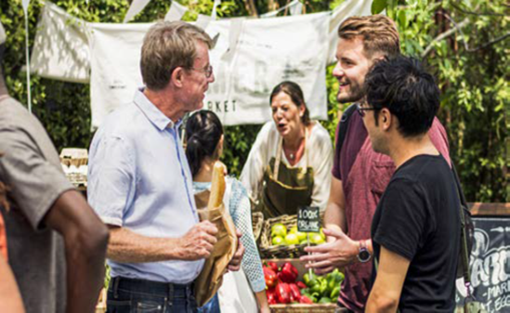
What is the GOAL of Advocating?
Provide information about agriculture
Empowers others to make informed decisions

Slide 6
How do you advocate?
Connect with people where they are
Tell your story
Recognize preconceived notions-yours not theirs
Be willing to answer questions openly and honestly
Know that effectively Advocating ≠ Convincing

Slide 7
So where do you start?
Tell your story using the SPIT technique.
S= Specific
P=Personal
I=Informative
T=Timely

Slide 8
S=Specific
Be specific in terms of what you want and what the audience wants.
Know what you want and be able and willing to ask for it.
Look for ways to connect your “ask” to what the audience wants.
Research the perspectives and interests of your audience.

Slide 9
P=Personal
Attract people to your cause through a compelling story.
What we are talking about has had, or will have, an impact on an actual human being.
How has your work helped someone find a job or, better, a career?
What have you done to improve people’s lives in your community?
How have you helped boost economic development and prosperity?

Slide 10
I=Informative
Wrap some facts and figures around your argument.

Slide 11
T=Timely
Contact the decision maker in a timely matter. Not too soon, not too late.
Be aware that circumstances may change around your initial contact.
Build a relationship over time.

Slide 12
The message formula…
Uses: meetings, written communication, phone calls.
My name is and I’m from [establish relevance by clarifying that you are a constituent]. I am here to ask for [specific ask].
Knowing of your interest in [specific to the audience], I think you’ll be interested, too.
This is important to the people I represent because
[personal story and information].
That’s why I hope you’ll [specific ask].
I’d like to follow-up by [date]. When can I get back to you?

Slide 13
Fact Gathering
Utilizing reliable and accurate online resources is essential.
Sites to utilize for gathering information on your topic:
Agfoundation.org/resources
Foodintegrity.org
Usfarmersandranchers.org

Slide 14
Tying it all together
Effective Advocacy: Let’s CHAT
C = Connect
Know your audience. Find a connection before sharing content. What people, issues, or interests do you have in common?
H = Hook
Get their attention with a strong statement about the issue or problem. Explain the impact on individuals and the community. Describe what outcome you are seeking and your solution for getting that result.
A = Ask
Ask for their support. Describe what you’d like them to do to reach the desired outcome.
T = Thank
Express your thanks for the meeting—and for their support!

Slide 15
After the conversation
Be sure to follow up with the following:
Thank you letter or email is applicable
Invitation to talk further
Answer any questions that may have been posed during the conversation that wasn’t answered or needed follow up

Slide 16
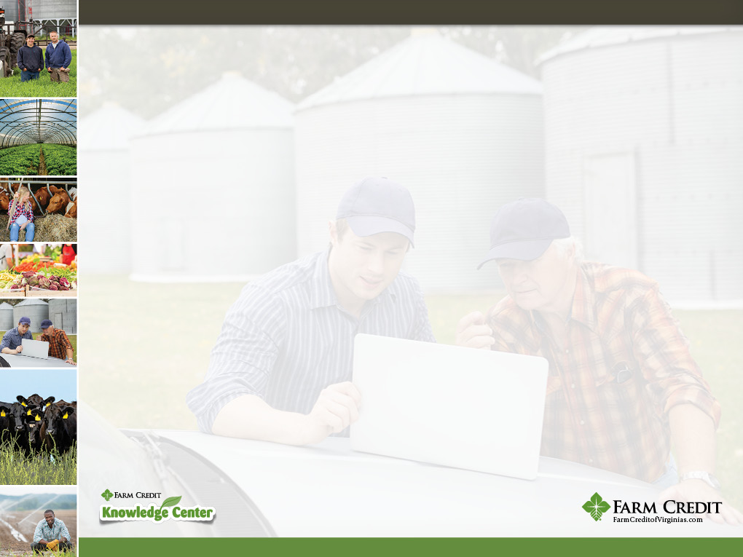
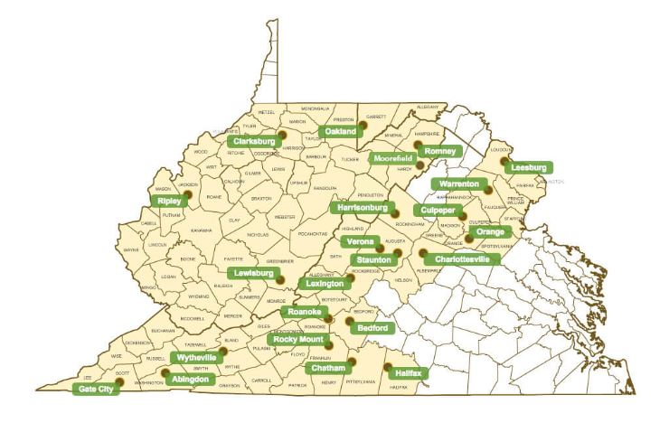
Who is Farm Credit?
The Farm Credit System is a nationwide network of lending cooperatives that serve rural America
Mission: to provide a reliable source of credit for American Agriculture by making loans and providing insurance to qualified borrowers

Slide 17
Farm Credit Knowledge Center
Our Mission: To Facilitate the Sharing of Knowledge and Resources within our Community for the Betterment of ALL Farmers and Those Interested in Agriculture
We serve as a “One Stop Shop” for Valuable Information, Data, Facts and Resources
Our team members are “Network Agents” where we strive to build relationships and make connections.
www.farmcreditknowledgecenter.com
Email: KnowledgeCenter@fcvirginias.com

