Slide 1

Challenges & Opportunities for Managing Economic Shockwaves
Dr. David M. Kohl
Professor Emeritus, Agricultural and Applied Economics
Member of Academic Hall of Fame, College of Agriculture & Life Sciences
Virginia Tech, Blacksburg, VA
Email: sullylab@vt.edu
February 17, 2022
August 15, 2022

Slide 2
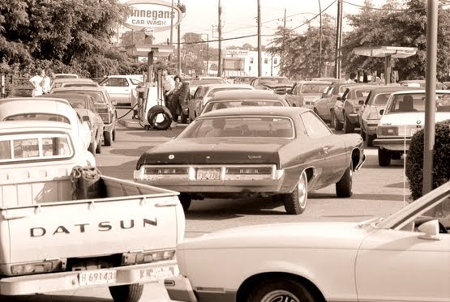
1978 to 1979 Déjà vu
High oil prices
International ag market uncertainty
Spiking land values
Stagflation
Political & military uncertainty
Technology acceleration

Slide 3

The State of the U.S. & Global Economies (1)
Ukraine Russia military conflict
  29% of world’s wheat
  14% of global corn exports
  80% sunflower exports
  Russian oil to India & China
  Fertilizer: potash & nitrogen
  One to five years disruption for energy & food
  One to five years for technology & infrastructure for natural gas exports to Europe

Slide 4

The State of the U.S. & Global Economies (2)
Food nationalism
  Export restrictions
50 countries dependent on Russia & Ukraine for more than 30% of imported wheat
Egypt & Turkey > 60% imports from Russia & Ukraine
Geo political risk
  Authoritarian & emerging economics vs. the west & rich nations
    Wear down the west strategy
    Create economic havoc in the rich nations
    Create regional social unrest

Slide 5
The State of the U.S. & Global Economies (3)
Energy security & green energy transition
  Fossil fuel imbalances
  Flip the switch on government policies
  Regions of the world - climate is secondary to the economy
  Watch the U.S. midterm elections this fall

Slide 6
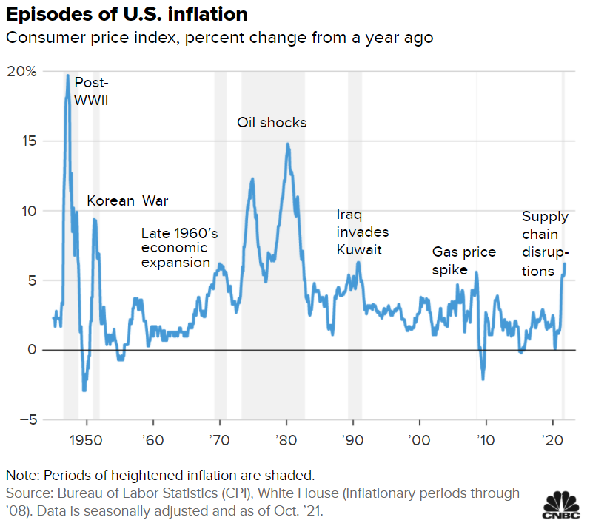
Episodes of U.S. Inflation
Consumer price index, percent change from a year ago

Slide 7
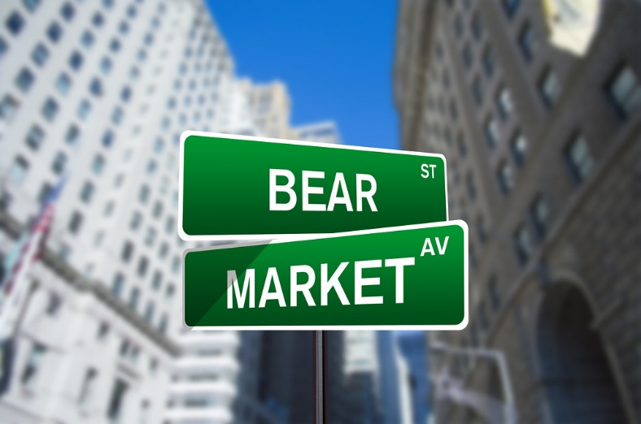
Federal Reserve & World Central Banks’ Panic
Wealth creates cycle 1970-2021
Wealth destruction cycle 2022- ???
Mama Bear & Papa Bear levels- “outlook”
  Stock market
  Cryptocurrency
  Housing & real estate
  Farm real estate
Behavioral economics in full swing

Slide 8
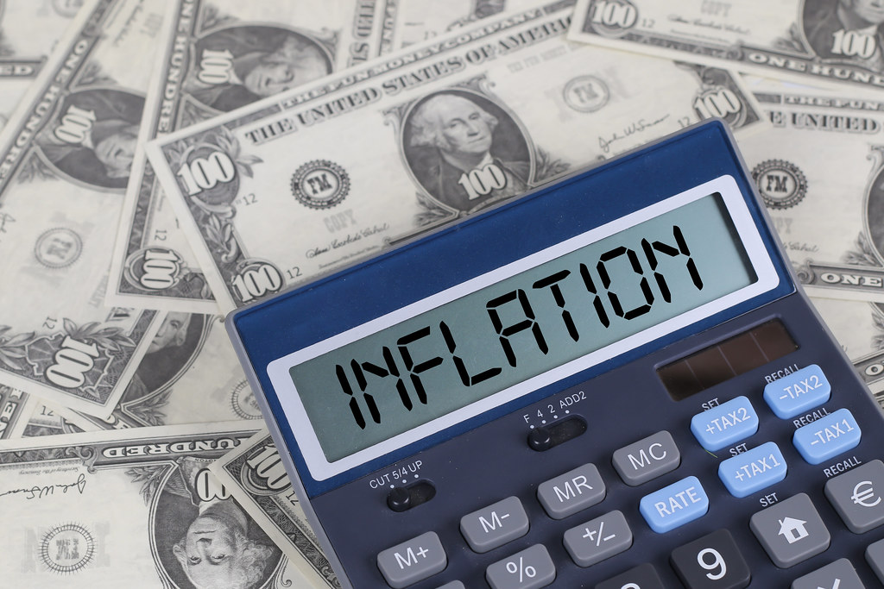
Federal Reserve Dilemma – Core & Headline Inflation- “Hard Habit to Break”
Supply chains
Weather
Government stimulus savings
Oil & energy
Geographic wealth shifts
Deglobalization
Federal reserve- “the villains”

Slide 9

Interest Rates – How High? When is the Next Recession?
Average rate increase 2.53%
Maximum rate increase 4.75%
Unemployment rates- a lag indicator
Early 2023 possible global recession
Stagflation

Slide 10

Lender & Business Dashboard Watch List
Indicator | Range | Light
Copper Prices | $3.75 to $5.00/Pound | Red
Consumer Sentiment | 50.0 to 72.8 | Red
LEI / Diffusion Index | Downward trend | Red
Purchasing Managers Index | Low 50’s | Yellow
Housing Starts | >1.5 Million | Green
Unemployment | 3.5% U-3/6.7% U-6 | Green
Factory Utilization | 75% - 80% | Green
Federal Debt | Approximately $30 Trillion | Red
Oil Prices | $65 to $125/Barrel | Yellow
Yield Curve | Flat to Inverted | Red
Updated 8/5/22

Slide 11
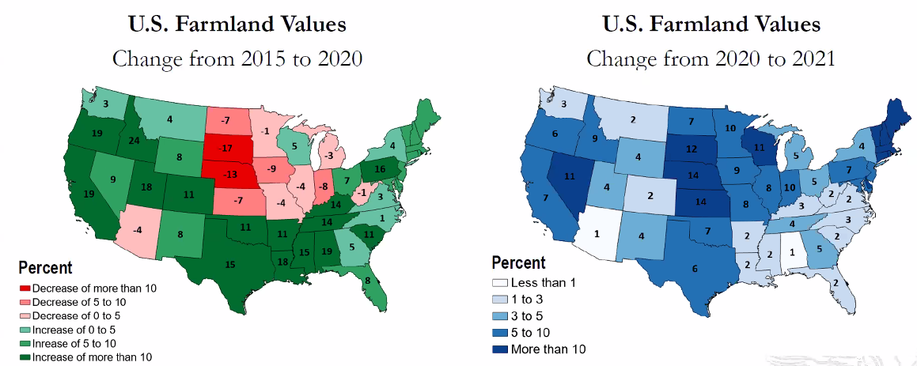
Farmland Values: Recent Observations
Source: USDA & Federal Reserve Bank of Kansas City

Slide 12
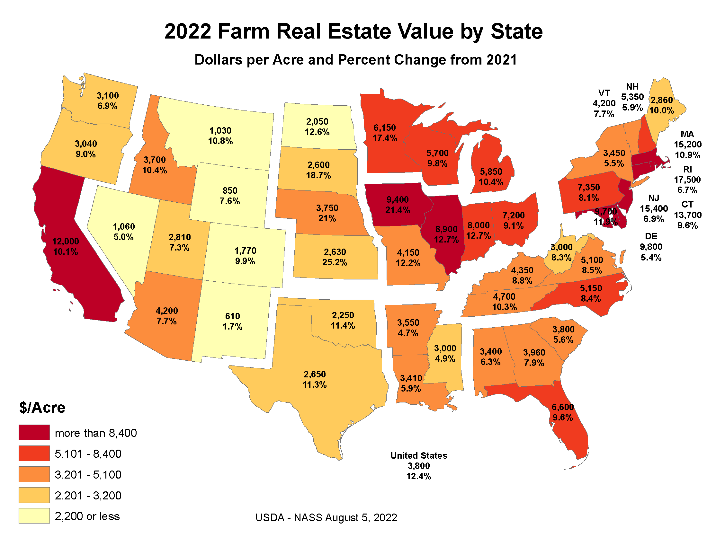
2022 Farm Real Estate Value by State
Sources: DTN Article link: Kansas Sees Highest Percentage Jump in Farmland Values (dtnpf.com)
USDA-NASS Land Value Report Link: https://release.nass.usda.gov/reports/land0822.pdf

Slide 13
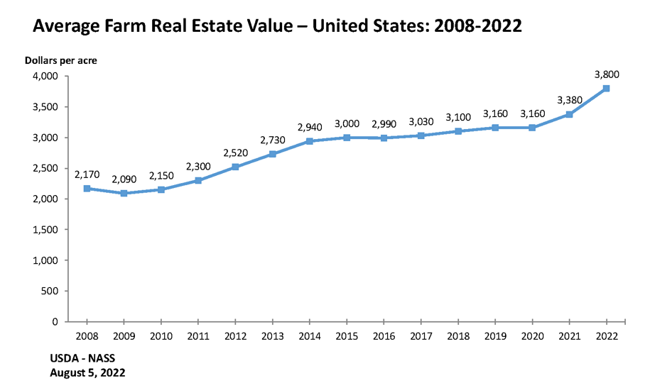
Average Farm Real Estate Value- United States 2008-2022
Source: https://www.nass.usda.gov/Charts_and_Maps/Land_Values/farm_value_hist_chart.php

Slide 14

Why Are Land Values in the 2020s Resilient?
  Baby boomer producers and landowners are in later stages of ownership with equity
  Interest rates have been stable
  Government payments to agricultural sector have been generous
  Rural renaissance
  Outside investors
    Solar/wind green payments
    Water & mineral resources
    Development for housing industry is strong
    Diversification of investments

Slide 15

Mega Trends-
Production/Consumer Paradigms
Plant, animal, human & environment
Air quality & pandemic
Weather in extremes
Carbon payments- mid decade
Cryptomania
Plant based proteins
Alternatives to dairy products
Local & regional movement
Urban agriculture
Soil & water health
ESG

Slide 16
Mega Trends- Positives for Agriculture
Importance of a diversified safe food, fiber & fuel source- basics of life
Reassurance of transparency in where food is produced, processed & distributed
Healthy soil & water
  Plants, humans, animals & environment
Niche markets, U.S. & globally
Repositioning of the image of agriculture

Slide 17
Future Business Models
Family business
  Cousins partnering with cousins
  Non-family members
  Separate enterprises/use common assets
Agri-entrepreneur
  Multi-tasker
  Gigs
  Diversified sources of income
Boomeranger professional
  “Outside the box” mindset
  New skill sets
Women, minorities, veterans
  Demographics of FFA, 4-H, MANRRS
Vertical & urban farming

Slide 18

Getting Comfortable With the Uncomfortable

Slide 19

Wisdom & Golden Rules of Business & Financial IQ
Planning – manage the controllables and manage around the uncontrollables
  Plan, strategize, execute, & monitor
  HUT principle
  Team of advisors to energize the process
  5 to 10% of the time
  Written business plan – 4X’s more profitable
  Mental health twice as strong
  Just in time vs. just enough – Plan for A, B, C, & D
“Failing to prepare, is preparing to fail.” - John Wooden, UCLA Coach

Slide 20
Wisdom & Golden Rules of Business & Financial IQ
Goal Setting
  80-16-4 Rule
  Six degrees of goal setting
  Short term- 1 year or less
  Long term- 3-5 years
  Goals should be S.M.A.R.T.
  Business, family & personal
  Mental, physical & spiritual
  20% of top producers have written goals
  Developing written goals: earn 4 times as much in lifetime
“Goals provide focus in a cluttered world.”

Slide 21
Wisdom & Golden Rules of Business & Financial IQ
Financial Liquidity & Cash “the bridge”
  Cash is trash ☹ - Wall Street Journal perspective
  Financial liquidity is a buffer to preserve wealth
  Financial liquidity provides proactive positioning for opportunity
  Financial liquidity is chokepoint
    Nation- “Russian example”
    Business- “financial & farm crisis”
    Personal household- “Dave Ramsey rule”
“Cash is the Queen on the chessboard.”

Slide 22
Wisdom & Golden Rules of Business & Financial IQ
Projected Cash Flow (Financial Sensitivity Analysis)
80% of the business plan
Best, average & worst case scenarios
Projected vs. actual analysis
Inflationary environment – three test
  Production price
  Input cost
  Interest rates
Overestimate capital expenditures by 25%
“Cash flow and financial sensitivity analysis provides financial guard rails.”

Slide 23
Business IQ: Management Factors
Critical Questions for Crucial Conversations

Slide 24

Action Plan for Young Producers
Goals
  Short run
  Long run
Balance sheet
Credit history
Projected cash flow
Business IQ

Slide 25

Q&A with Dr. Kohl

Slide 26
Dr. David Kohl’s
Contact Information:
Online Articles:
Road Warrior of Agriculture
  https://www.farmprogress.com/road-warrior
Ag Globe Trotter
  https://www.northwestfcs.com/ag-industries/economic-updates
Dave’s GPS & Dashboard Indicators
  https://www.farmermac.com/news-events/daves-gps/
Office:
(540) 961-2094
Alicia Morris
Scheduling:
(540) 493-2724
Angela Meadows
Email:
sullylab@vt.edu

