Slide 1

Jeopardy!
Tutorial
This template is ready to use but since Jeopardy! is a quiz show, you can change the questions and answers of the template, in order to adapt the game to your topics.
Please do not delete whole slides, otherwise we can not guarantee a smooth game experience and problems may occur.
However, you can change texts, the music and colours. In the next slides we will give you a detailed explanation to learn how to play the game and adapt it to your ideas.
Have a lot of fun with our JEOPARDY! game!

Slide 2
Rules of Jeopardy!
To start the game, click on the first Jeopardy! Slide and start the presentation by clicking on the menu Slide Show > From Current Slide.
Now the intro with music starts playing and you only must click one more time to run the begin animation. When the second money board appears, the first player can choose the category and money- value by clicking on the field. (With the increasing amount of money, the difficulty of the questions also increases!)
As soon the question appears, the players have 30 seconds to think about it. (until music ends) When one person raises his arm (or shouts) he/ she can answer. Answers must be phrased as questions, unless it’s said differently.
Right answer? Then the player gets the amount of money, the question is worth. Take a sheet and write down the value to the persons' name. If he guessed it wrong, the other players could try their luck. If time runs out, or no one got it, no one will get any points. The person with the highest amount of money, wins.
Advanced version: guessing it wrong will subtract the amount of money from the players account; negative values are also accurate.

Slide 3
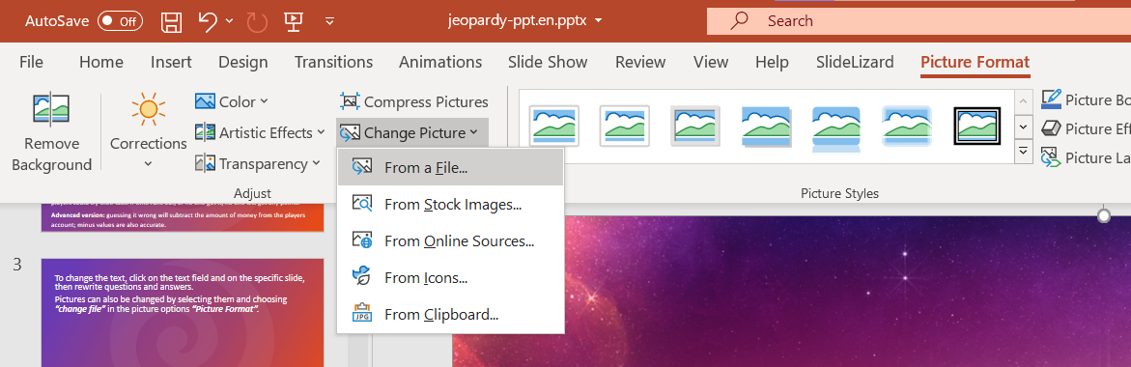

To change the text, click on the text field on the specific slide, then rewrite questions and answers.
Pictures can also be changed by selecting them and choosing “From a File” in the picture options “Picture Format”.
Some pictures are hidden behind other elements. In order to change them, move objects around and bring them to the front or back by right-clicking them and choosing the option.

Slide 4

More information can be found on our blog:
https://slidelizard.com/blog/jeopardy-powerpoint-template

Slide 6

PLEASE CLICK TO START THE GAME!

Slide 7







$ 200
$ 200
$ 200
$ 200
$ 200
$ 200
$ 400
$ 400
$ 400
$ 400
$ 400
$ 400
$ 600
$ 600
$ 600
$ 600
$ 600
$ 600
$ 800
$ 800
$ 800
$ 800
$ 800
$ 800
$ 1000
$ 1000
$ 1000
$ 1000
$ 1000
$ 1000

Slide 8


Slide 9
Family

Slide 11
PRODUCTION

Slide 13
DID YOU KNOW?

Slide 15
Genus

Slide 17
OVERVIEW

Slide 19
PICTURE PERFECT

Slide 20























































FAMILY
DID YOU KNOW?
PICTURE PERFECT
PRODUCTION
GENUS
OVERVIEW
YOU FINISHED THIS GAME
TIME TO COUNT THE MONEY!

Slide 21
Tomatoes are a part of the _________ Family
Click here for the answer

Slide 22
Solution:
Solanaceae
$ 200

Slide 23
Corn and Wheat are a part of the ______
Family
Click here for the answer

Slide 24
Solution:
Poaceae
$ 400

Slide 25
Apple and Peach are a part of the ______
Family
Click here for the answer

Slide 26
Solution:
Rosaceae
$ 600

Slide 27
Peanut and Soybean are a part of the ______
Family
Click here for the answer

Slide 28
Solution:
Fabaceae
$ 800

Slide 29
Acorn Squash, Cantaloupe, and Watermelon are a part of the ______
Family
Click here for the answer

Slide 30
Solution:
Cucurbitaceae
$ 1000

Slide 31
Corn is grown in every continent except _____________
Click here for the answer

Slide 32
Solution:
Antarctica
$ 200

Slide 33
Approximately 15% of the pumpkin acreage is used to make _________
Click here for the answer

Slide 34
Solution:
Processed pumpkin products
$ 400

Slide 35
_________ is the top producer of sweet potatoes in the U.S.
Click here for the answer

Slide 36
Solution:
North Carolina
$ 600

Slide 37
U.S. Farmers grow about ______________ acres of wheat
Click here for the answer

Slide 38
          Solution:
50 Million
$ 800

Slide 39
In 2017, the United States produced ___________ pounds of strawberries
Click here for the answer

Slide 40
Solution:
1.6 billion
$ 1000

Slide 41
There are over _____ varieties of pumpkins
Click here for the answer

Slide 42
Solution:
100
$ 200

Slide 43
There are over ________ varieties of tomatoes worldwide
Click here for the answer

Slide 44
Solution:
10,000
$ 400

Slide 45
70% of a strawberry’s roots are located in the top ______ inches of soil
Click here for the answer

Slide 46
Solution:
Three
$ 600

Slide 47
Soybeans make great ________. One acre of soybeans can make 82,363 _______
Click here for the answer

Slide 48
Solution:
Crayons
$ 800

Slide 49
The blueberry is one of the only foods that is truly naturally blue in color. The pigment that gives blueberries their distinctive color is called _______________
Click here for the answer

Slide 50
Solution:
Anthocyanin
$ 1000

Slide 51
Apple is a part of the ________ Genus
Click here for the answer

Slide 52
Solution:
Malus
$ 200

Slide 53
Watermelon is a part of the ________ Genus
Click here for the answer

Slide 54
Solution:
Citrullus
$ 400

Slide 55
Peach is a part of the ________ Genus
Click here for the answer

Slide 56
Solution:
Prunus
$ 600

Slide 57
Mushroom is a part of the ________ Genus
Click here for the answer

Slide 58
Solution:
Agaricus
$ 800

Slide 59
Leek is a part of the ________ Genus
Click here for the answer

Slide 60
Solution:
Allium
$ 1000

Slide 61
The science of apple growing is called _________
Click here for the answer

Slide 62
Solution:
Pomology
$ 200

Slide 63
There are more than ________ varieties of edible mushrooms
Click here for the answer

Slide 64
Solution:
2000
$ 400

Slide 65
Leeks are _______ tolerant
Click here for the answer

Slide 66
Solution:
Frost
$ 600

Slide 67
_____ is National blueberry month
Click here for the answer

Slide 68
Solution:
July
$ 800

Slide 69
Approximately ____ peanuts are needed to make a 12 oz. jar of peanut butter
Click here for the answer

Slide 70
Solution:
540
$ 1000

Slide 71
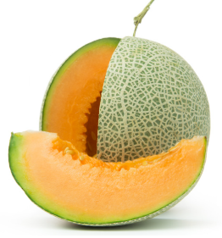
What is pictured below
Click here for the answer

Slide 72
Solution:
Cantaloupe
$ 200

Slide 73
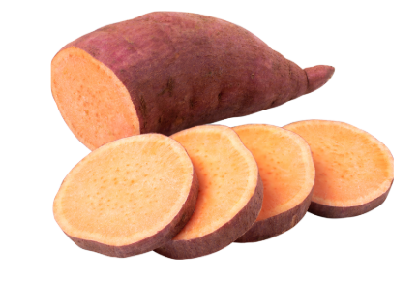
What is pictured below
Click here for the answer

Slide 74
Solution:
Sweet Potato
$ 400

Slide 75

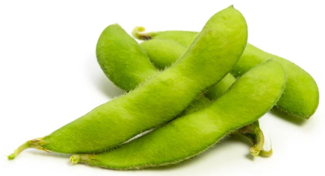
Click here for the answer

Slide 76
Solution:
Soybean
$ 600

Slide 77

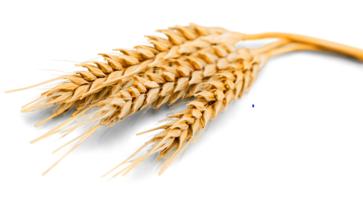
Click here for the answer

Slide 78
Solution:
Wheat
$ 800

Slide 79

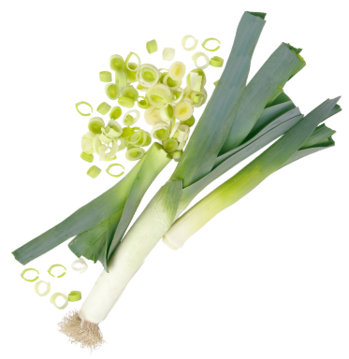
Click here for the answer

Slide 80
Solution:
Leek
$ 1000

Slide 81


Free Download:
https://slidelizard.com

