Slide 1
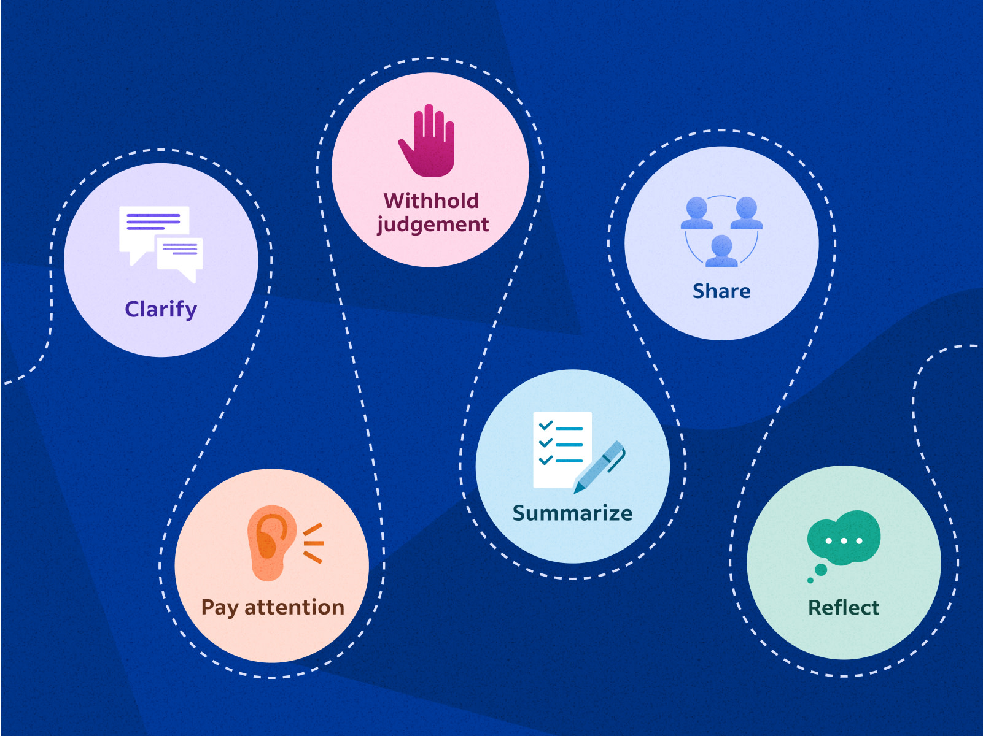
Active listening
Picture from Indeed.com
Notes:
https://www.indeed.com/career-advice/career-development/active-listening-skills

Slide 2
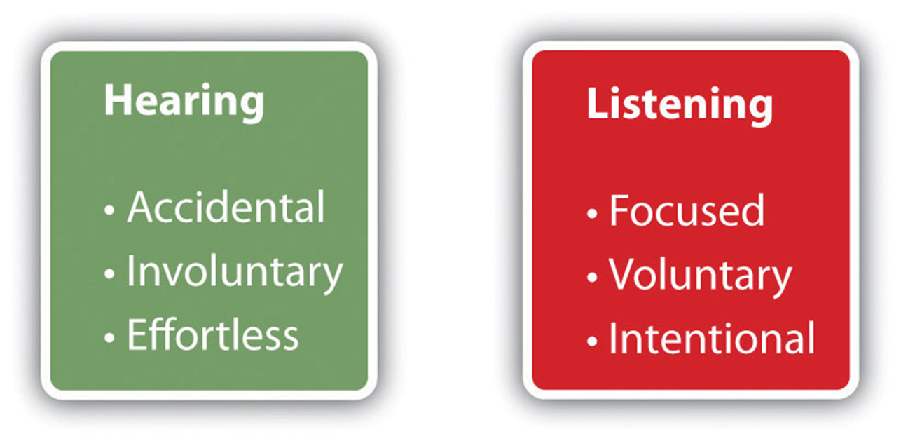
What is active listening?
The ability to focus completely on the person speaking in order to understand their message and be able to comprehend the information and respond thoughtfully.
Can recall specific details without the speaker having to repeat them
Use verbal and non-verbal cues to show you are actively listening

Slide 3
How to become an active listener

Slide 4
Paraphrase
Summarize main points
Example: Someone is explaining to you the most important EPD’s they are looking at during an upcoming bull sale.
“I understand, you are looking for a bull with a low birth weight”

Slide 5
Open-ended questions
Questions that allow for more than a yes/no response
Example: Someone is telling you that they are going into their ninth year of selling at a farmers market.
“What has been the largest challenge you have faced while selling at the farmers marker?”

Slide 6
Probing questions
Questions that narrow down a broad subject, has them provide more details
Example: Someone is telling you about their garden
“Tell me about what you are planting. Which one is the hardest to maintain?”

Slide 7
Short verbal affirmations
Short, positive statements. A way to show you are listening without interrupting
Examples: I agree
That makes sense
Interesting
I understand
I like that

Slide 8
Display empathy
Not only recognize, but share the other persons feelings
Showing compassion, establish a sense of mutual trust
Example: Someone is explaining to you that their vehicle broke down
“I am so sorry to hear this, can I help you figure out what is wrong?”

Slide 9
Share similar experiences
Discuss comparable situations
If they share a problem they are having discuss a similar issue you may have had and how you overcame it
Example: Someone is telling you about having difficulty with a coworker
Share a time that you had an issue with a friend or coworker and how you personally overcame it.

Slide 10
Recall previously shared information
Remember key concepts, ideas or other critical points from prior conversations
Example: “Last month you mentioned trying a new feed. How is that working out?”

Slide 11
Non-verbal Active Listening
Nod
Smile
Avoid distracting movements
Maintain eye contact
Pair well with short verbal affirmations

Slide 12
Pick a partner and have a conversation about what you did yesterday
Be sure to use 5 different active listening skills
we just learned about

