Slide 1
ADDITIONAL ETHICS
AND ETIQUETTE

Slide 2
Social Media
Always be kind and respectful
Your “online” appearance matters
Have an appropriate email address
Make sure that your social media accounts look professional
  Be careful what you post or share
  For any accounts that allow it, be sure to set them to requiring approval for tagging/mentioning
Assume that employers/schools/scholarships WILL look
1 in 10 people post something that could harm their employment
Think about what you post from your employers perspective

Slide 3
Cultural etiquette
Be aware of other countries business and cultural norms. Find out what is professional and acceptable.
  Examples
    In Japan a business card is very important, don’t play with it, write on it, or put it in you pocket
    In the United Kingdom a tap on the nose means they are telling you something confidential
    In Australia, be sure to be early. Punctuality is very important.
Take a few minutes to research another country and a business custom they have!
Notes:
https://www.businessnewsdaily.com/5176-unusual-international-business-customs.html

Slide 4
Dress code
Nice (non-jean) pants and a nice (not too fitted) top with nice (but practical) shoes, is almost always appropriate
It is STILL better to be overdressed than underdressed
Ladies – too fitted, too low, too short is a no-go
Gentlemen – ditch the hats, appropriately sized jeans
No holes and no gum!
It is acceptable to ask for clarification on what dress is appropriate

Slide 5
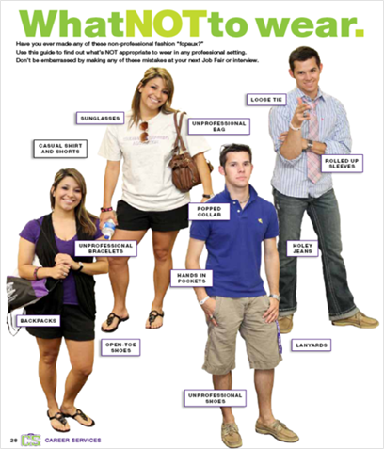

Slide 6
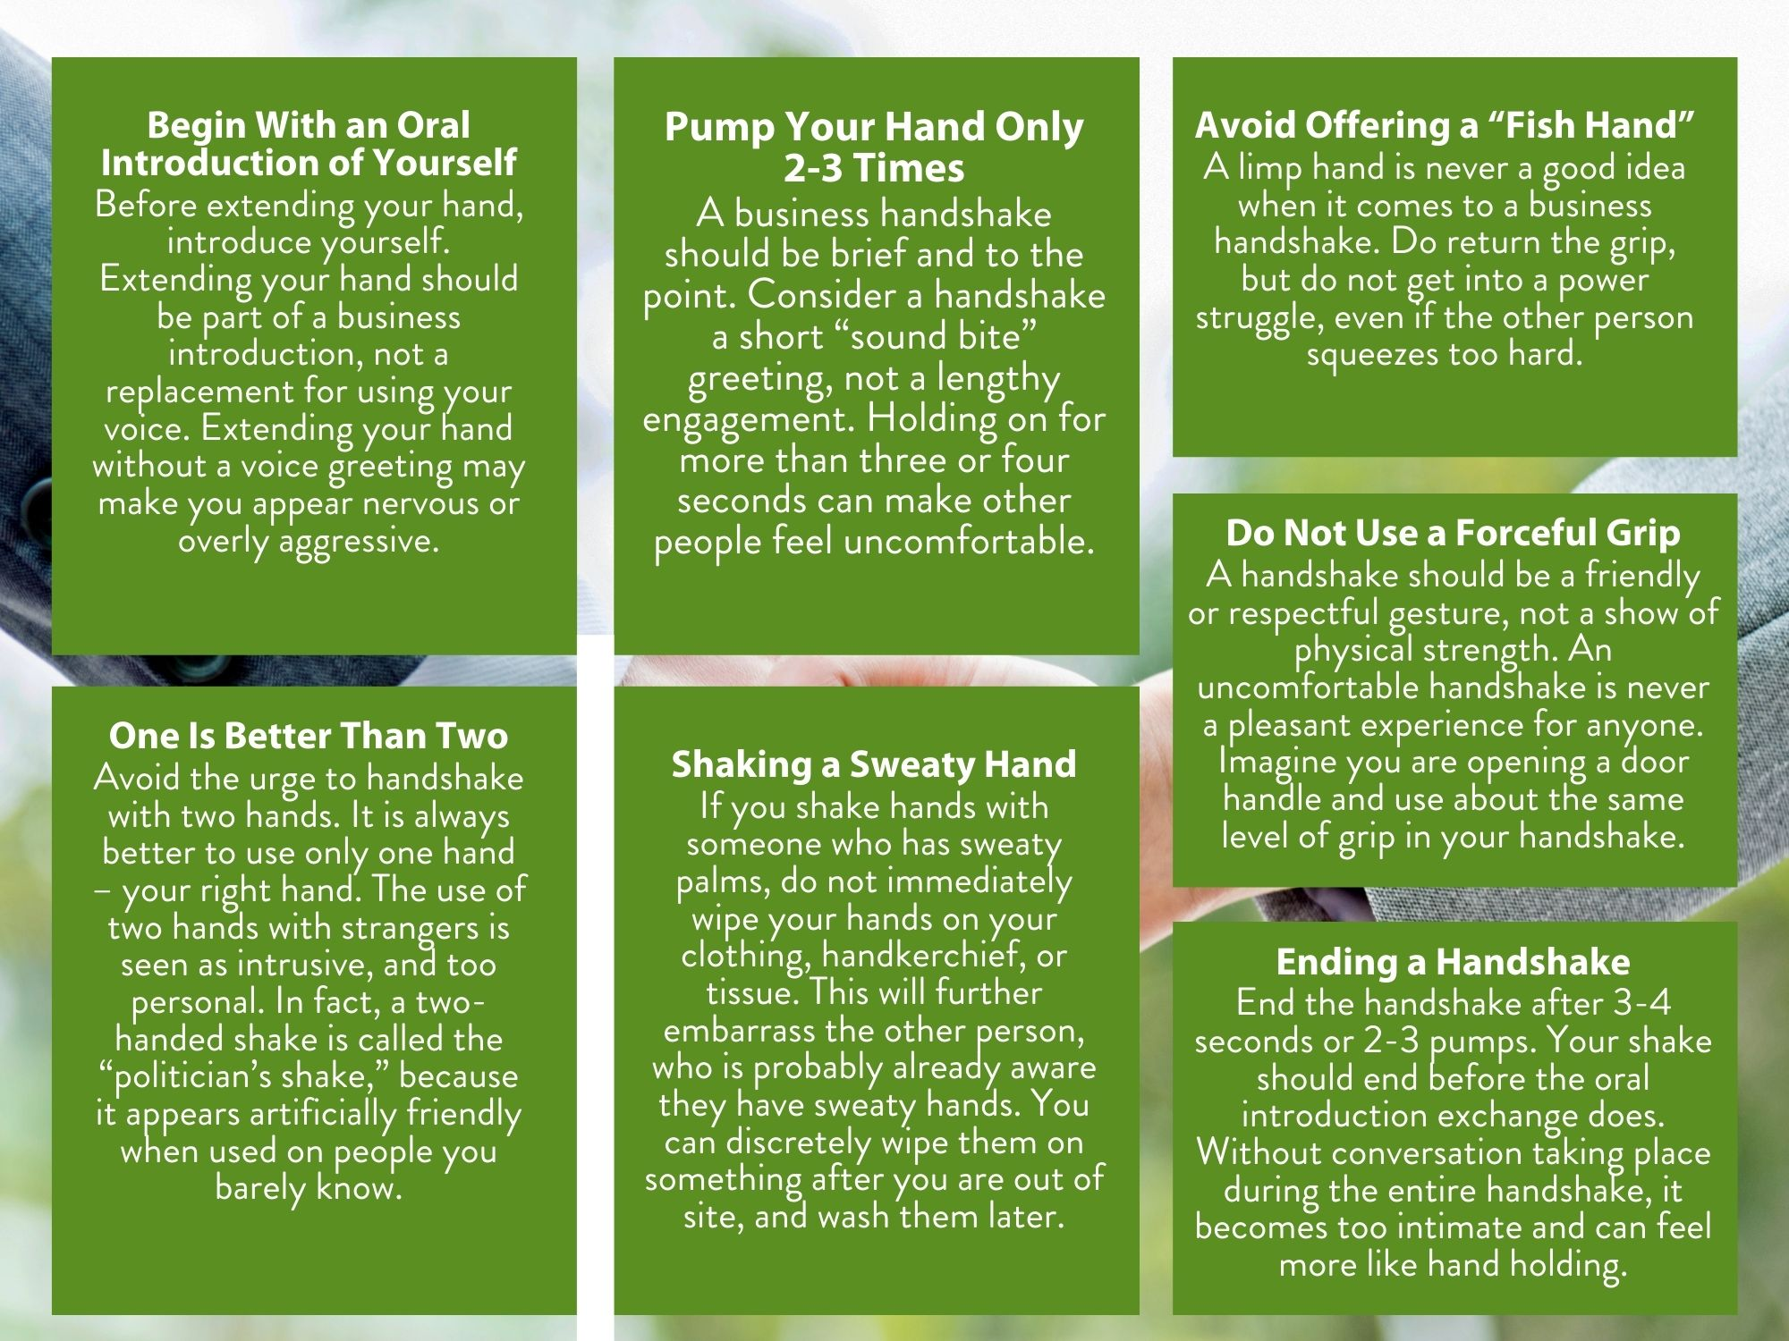
Handshake
Grab a partner and practice a good handshake! It is okay to give constructive criticism.

