Slide 1
DINING ETIQUETTE
Notes:
https://www.kent.edu/career/dining-etiquette

Slide 2
What is dining etiquette?

Slide 3
Reception or social hours
Always keep one hand free
Introduce yourself standing
Introduce yourself to the host/hostess
Don’t interrupt individuals in conversation
Pay attention to others body language and know when it is time to end a conversation

Slide 4
Basics
Arrive on time or call if you know you will be late
Do not place personal items on the table
Have proper posture and try to keep your elbows off the table

Slide 5
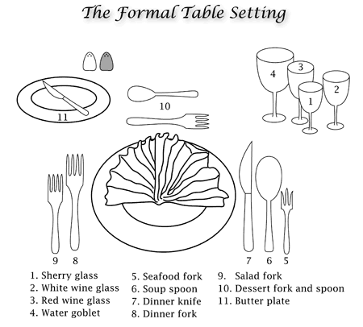
Table setting
Fun Fact
Fork and left both have four letters
Spoon/Knife and Right both have five letters
Draw this in your notes to have for later
You may not always use all utensils pictured

Slide 6
Ordering/being served
Try to avoid the most expensive item on the menu
Try to avoid appetizers or desserts unless the host encourages it
Try to avoid messy/difficult to eat foods
Ex. Spaghetti
Place your napkin on your lap
Wait for everyone else to be served before you begin eating

Slide 7
During the meal
Try to eat slowly, only cutting a few bites of your meal at a time can be helpful
Chew with your mouth closed, do not talk with food in your mouth
If there are items to pass around the table pass them to your right
If you are the person that begins the passing start by offering the person to your left, take some for yourself, then pass right.
Pass salt and pepper together
If eating soup, stir to cool it, do not blow on it. Spoon soup away from you
Bread should be eaten by tearing it into small pieces and buttering a few bites at a time

Slide 8
Once you have finished
Leave your plates in the same position, do not push them
Lay your fork and knife diagonally across the plate, side by side to signify to the wait staff that you are finished
If this is an event you are paying, tips are generally 15% for moderate service and 20% for excellent service
Always thank your wait staff and host.

Slide 9
Let’s practice proper dining etiquette

