Slide 1
ETHICS AND ETIQUETTE

Slide 2
Vocabulary
Ethics
  a theory or system of moral values
Etiquette
  the customary code of polite behavior in society or among members of a particular profession or group.

Slide 3
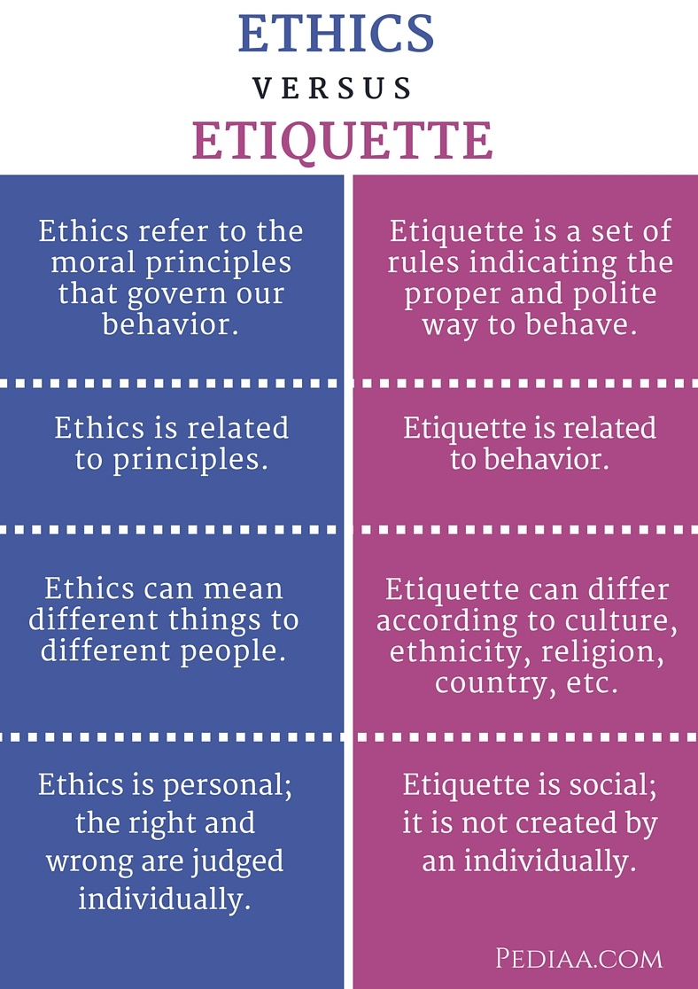
Difference between ethics and etiquette

