Slide 1
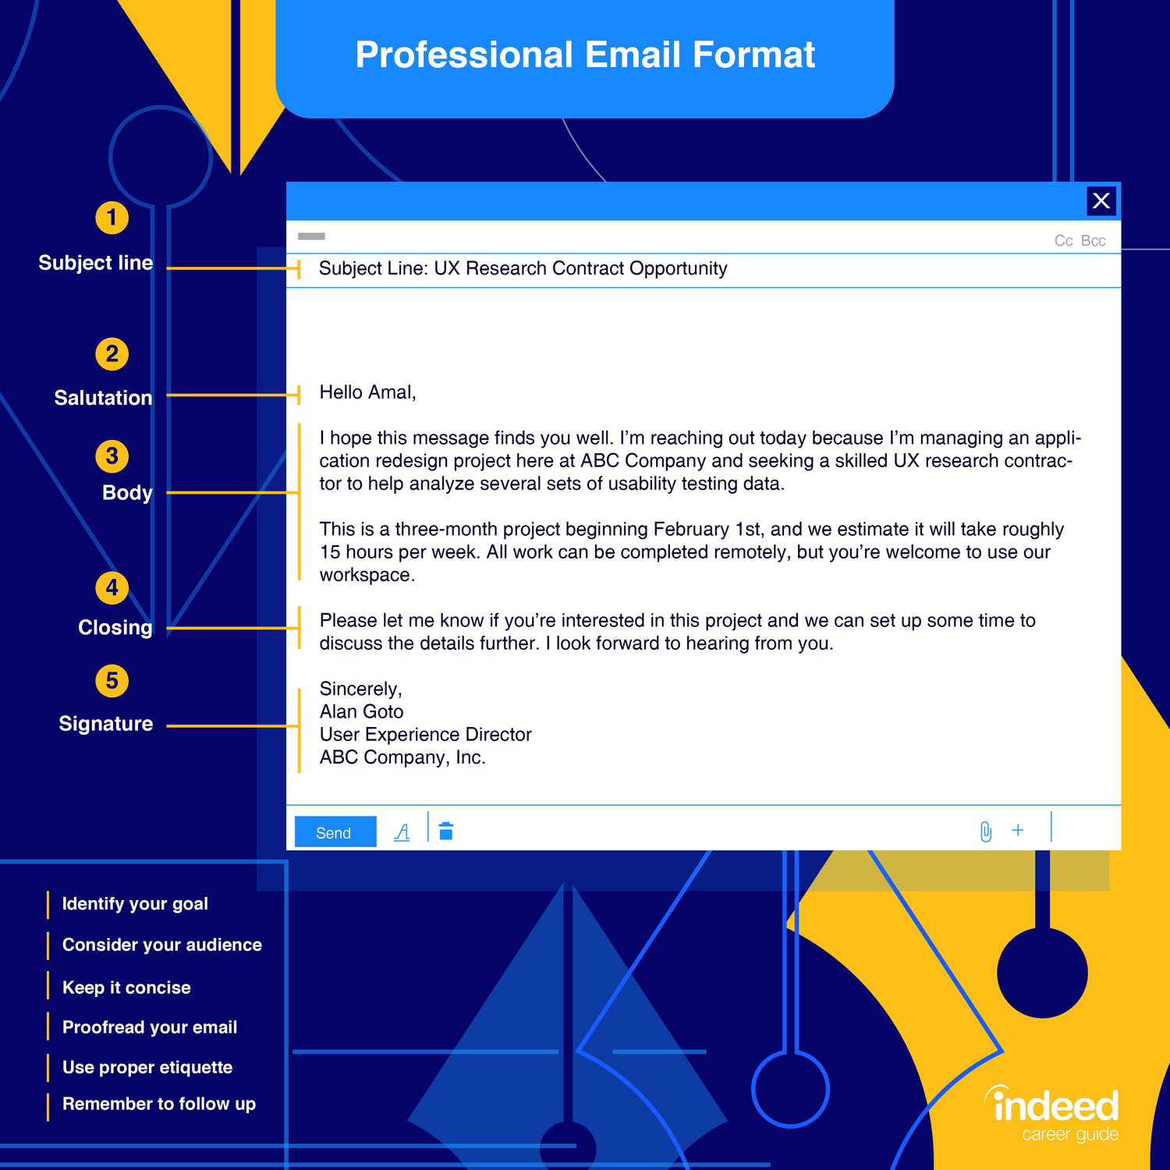
HOW TO FORMAT AN EMAIL
Notes:
https://www.indeed.com/career-advice/career-development/how-to-write-a-professional-email

Slide 2
Five steps to formatting an email
Subject line
Salutation
Body
Closing
Signature

Slide 3
Subject line
A short phrase to summarize the communication
Subject: Farm tasks for the week

Slide 4
Salutation
The first line of the email
A greeting
Good morning
Hello
Good afternoon
It is acceptable to use the persons name
Good morning Chase,

Slide 5
Body
The body is what you want to tell the person receiving the email.
I hope you had a good weekend! This week there are several goals that we must accomplish on the farm. We will need to work the steers, spray the corn, change the oil in the tractors, and finish hauling all of the hay. Your daily chores will remain the same until we find another farm hand.

Slide 6
Closing
The wrap up of your email
Reiterate any requests previously made in the email
Can be a forward looking statement
If you have any questions or issues regarding the tasks at hand for the week, please reach out. I look forward to the progress we will make as a team this week!

Slide 7
Signature
Identify yourself
This can include your name, position, contact information or other pertinent information
Sincerely,
Abigail Smith
Farm Manager, 123 Farm
Phone – (123)-456-7891

Slide 8
Putting it all together
Subject: Farm tasks for the week
Good morning Chase,
I hope you had a good weekend! This week there are several goals that we must accomplish on the farm. We will need to work the steers, spray the corn, change the oil in the tractors, and finish hauling all of the hay. Your daily chores will remain the same until we find another farm hand.
If you have any questions or issues regarding the tasks at hand for the week, please reach out. I look forward to the progress we will make as a team this week!
Sincerely,
Abigail Smith
Farm Manager, 123 Farm
Phone: (123)-456-7891

