Slide 1
NONVERBAL
COMMUNICATION

Slide 2
What is nonverbal communication?
Take a few minutes to write down anything that you think related to nonverbal communication

Slide 3
Nonverbal communication relies on physical movement, tone, and interpretation
It isn’t what you said, it’s how you said it.

Slide 4
Examples of nonverbal communication
Body language
Movement
Posture
Gestures
Space
Paralanguage
Facial expressions
Eye contact
Touch

Slide 5

Body language
The gestures, movements, and mannerisms by which a person or animal communicates with others
  Arms crossed could mean angry or nervous
  Head down could mean shy or sad

Slide 6

Movement
the act or process of moving
  Fidgeting in a meeting could mean you are bored

Slide 7
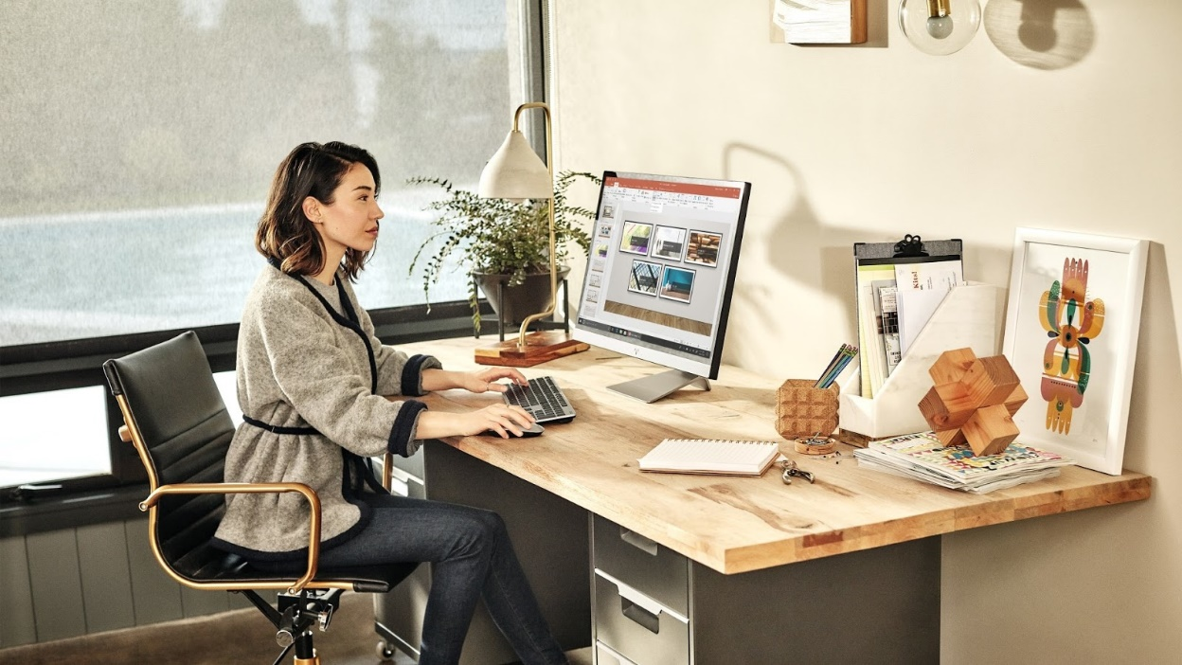
Posture
the position or bearing of the body whether characteristic or assumed for a special purpose
  Someone may sit up straight with their shoulders back to convey being attentive

Slide 8

Gestures
a movement usually of the body or limbs that expresses or emphasizes an idea, sentiment, or attitude
  Thumbs up could mean confirmation or feeling positive
  Pointing at something
  Fingers crossed could mean good luck

Slide 9
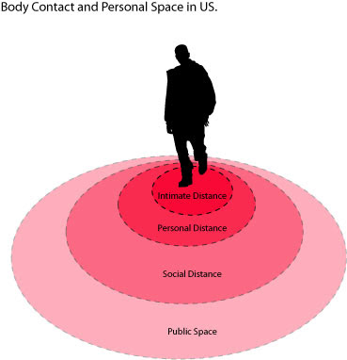
Space
How close/far away you stand from a person or they stand from you
  Standing farther away could mean less comfortable around the person
  Too close is not respecting personal space

Slide 10
Paralanguage
Optional vocal effects (such as tone of voice) that accompany or modify the phonemes of an utterance and that may communicate meaning
  Talking quickly and high pitched could mean excited
  Quiet could mean shy

Slide 11

Facial Expressions
Most common form of nonverbal communication
  Open eyes wide when surprised
  Smile means happy

Slide 12
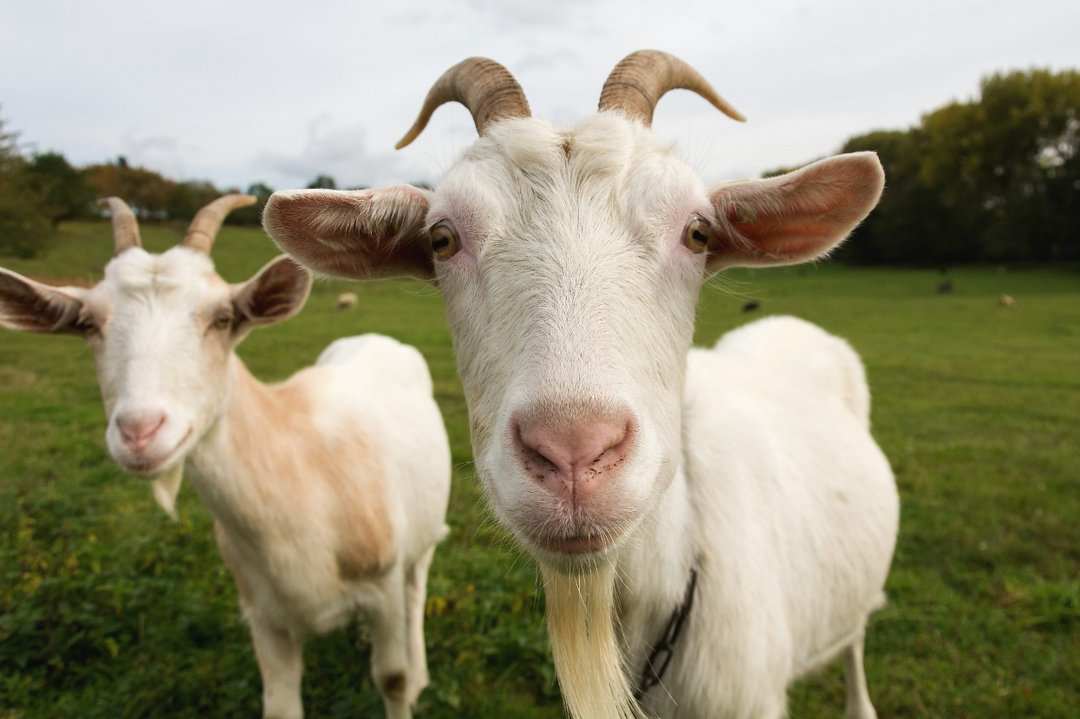
Eye Contact
visual contact with another person's eyes
  Looking away or at the ground could mean disinterest

Slide 13
Touch
handle or feel gently usually with the intent to understand or appreciate
  Putting hand on a friends shoulder to show comfort
  Should be used sparingly and only when the other person is receptive

Slide 14
Give it a try

