Slide 1
TIME MANAGEMENT
TECHNIQUES
"The bad news is time flies. The good news is you're the pilot.“
-- Michael Altshuler

Slide 2
Pomodoro Technique
The idea is that you can accomplish large tasks by breaking them into smaller intervals
  Choose what task(s) you need to complete
  Set a 25 minute timer. At this time you will begin completing your task
  Once the 25 minute timer goes off set a 5 minute timer. These five minutes should be used a break.
  Repeat the process until the task is complete. Every 4 – 25 minute intervals take a 20 minute break instead of 5.
Tips and Tricks
Limit distractions. Put your phone on airplane or silence mode
Don’t feel like you have to take the breaks if you don’t need them
Don’t take your break in the same place you are working
https://www.youtube.com/watch?v=mNBmG24djoY
Notes:
https://www.youtube.com/watch?v=mNBmG24djoY

Slide 3
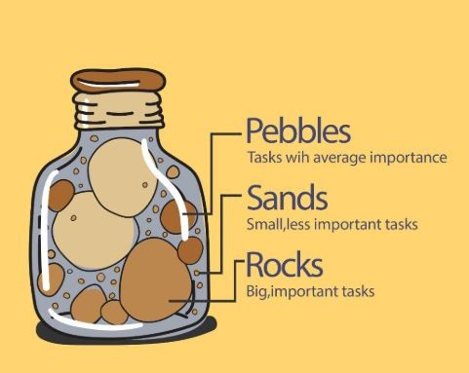
Pickle Jar
The pickle jar theory lets individuals visualize their time and tasks
It is important to put the big items in first and fill others in around it.
You can do this physically or draw it
  Have three to four rocks (big, important tasks)
  You can have a handful of pebbles (less important tasks)
  Have a handful of sand (average tasks)
https://www.linkedin.com/pulse/time-management-pickle-jar-theory-shadav-mohammad-ansari
Notes:
https://www.linkedin.com/pulse/time-management-pickle-jar-theory-shadav-mohammad-ansari#:~:text=Rocks%20(high%20priority)%20are%20always,to%20yourself%E2%80%94commitments%20you%20keep.

Slide 4
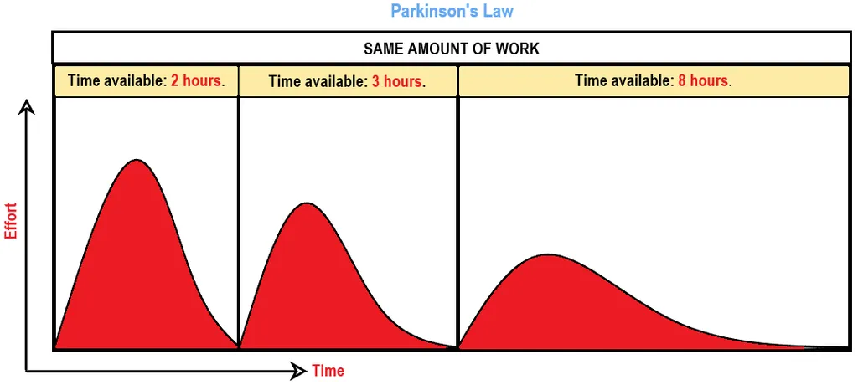
Parkinson’s Law
The law states that the more time you have available the more time you will spend doing the task even if you could have finished it in less time.
The longer a task takes the less effort, but same amount of work
https://www.youtube.com/watch?v=xPd0Qt7OmxE
https://www.consuunt.com/parkinsons-law/
Notes:
https://www.youtube.com/watch?v=xPd0Qt7OmxE
https://www.consuunt.com/parkinsons-law/

Slide 5
ABC method
C
Yard work
1. Mow the yard
2. Weed eat
B
Clean Stalls
1. Cows
2. Sheep
A
Feed
1. Cows
2. Sheep
The ABC method assigns priority to tasks
  A = Most important
  B = Less important
  C = Least important
Once tasks have a letter they can be assigned a number
https://www.aiuniv.edu/blog/2014/march/time-management-tips-abc-list

Slide 6
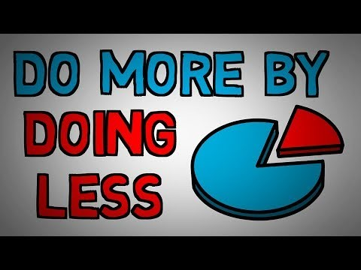
Pareto Principle
Also referred to as the 80/20 rule
  20% of input = 80% result
Notes:
https://www.youtube.com/watch?v=EAynHZE-lK4

Slide 7
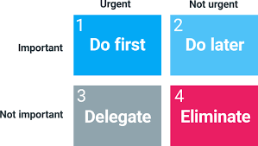
Eisenhower Matrix
Also called Time management matrix or urgent/important matrix
Categorize tasks based on urgency and importance.
https://www.eisenhower.me/eisenhower-matrix/
Notes:
https://www.eisenhower.me/eisenhower-matrix/

Slide 8
There are lots of time management techniques!
Find a partner and research one we didn’t cover! Then share it with the class!

Slide 9
Let’s review!

Slide 10
What Technique is this?
Pomodoro
Greg needs to write a business plan
  Greg decides he will complete his marketing strategies and ideas
  He sets a 25 minute timer and begins to work with his phone on airplane mode.
  The timer goes off and Greg gets up and walks to get a drink of water
Notes:
Pomodoro

Slide 11
What Technique is this?
ABC
Lauren is a Feed Store manager she needs to order new supplies, hire a new employee, and do a quarterly financial report. She decides to break these tasks down into most important to least important and add subcategories. What technique did Lauren decide to use?
C
Hire a new employee
1. Schedule interviews
2. Hold Interviews
B
Quarterly financial report
1. Gather required information
2. Input all information
A
Order New Supplies
1. Feed
2. Company shirts

Slide 12
What Technique is this?
Eisenhower Matrix
Gordon is a Farm Manager. Every morning before he starts work he breaks down his tasks based on importance and urgency. What technique does Gordon use?
Urgent | Not Urgent
Important
Not Important
Feed | Vaccinate cattle
Fix four wheeler | Play on phone

