Slide 1
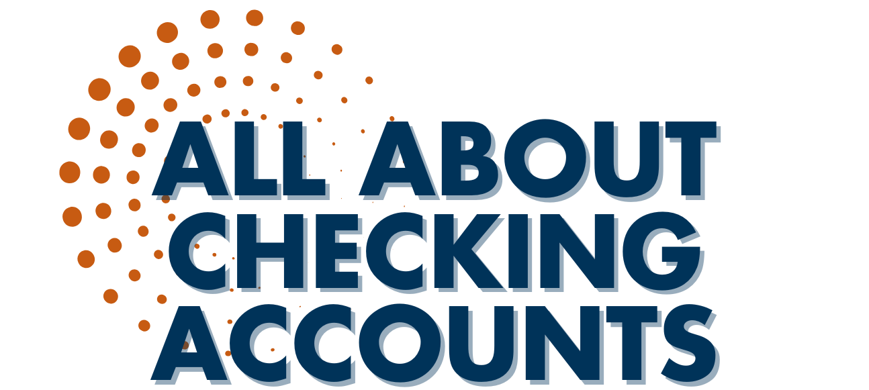

Slide 2
What is a Checking Account?
Common financial service used by many consumers
Services and fees vary depending upon the financial institution
Funds are easily accessed
Check
ATM
Debit Card
Telephone
Internet
Mobile Banking App

Slide 3
Why do People Use Checking Accounts?
Reduces the need to carry large amounts of cash
Convenience – useful for paying bills
Spending plan tools
Keeps a record of where money is spent

Slide 4
What is a Check?
Used at the time of purchase as a form of payment
Used to pay bills through the mail
Piece of paper pre-printed with the account holder’s:
Name and address
Check number
Financial institution
Identification numbers

Slide 5
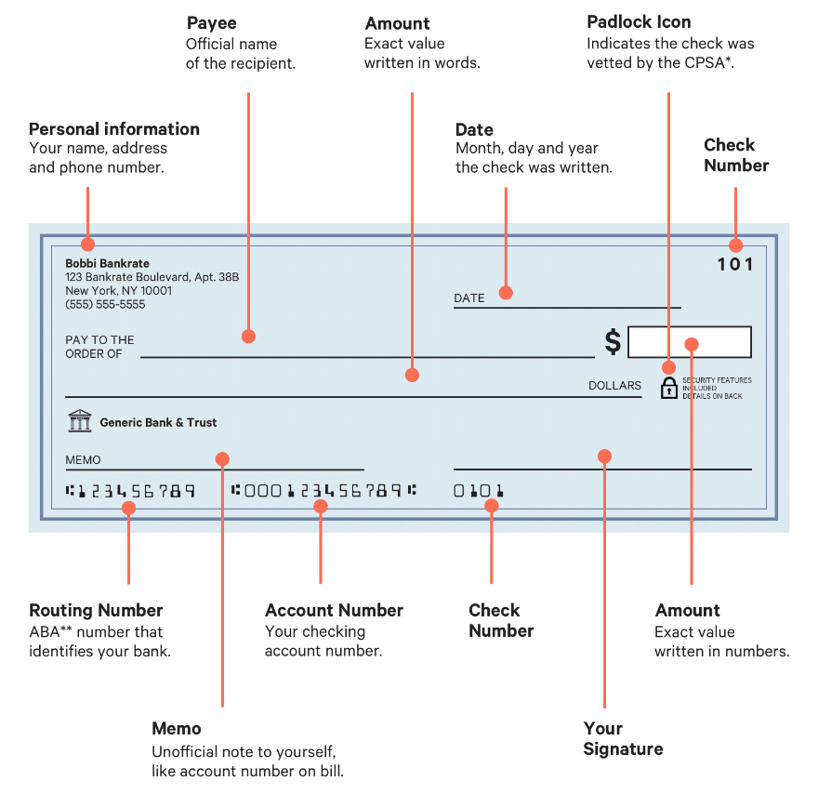
Parts of a Check
Check
Number
Unique identifier printed on each check.
Check
Number
Unique identifier printed on each check.
Your
Signature
Handwritten name that authorizes the bank to release the funds.

Slide 6
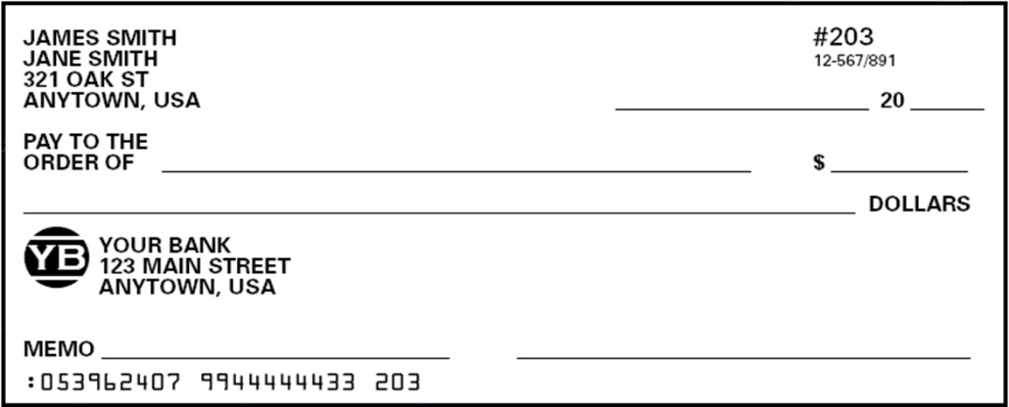
How Do You Write a Check?
DATE
PAYEE
AMOUNT in numbers
4. AMOUNT in words
5. MEMO
6. SIGNATURE
1
DATE
2
3
4
5
6

Slide 7
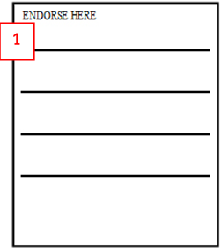
How Do You Cash a Check?
Blank Endorsement
1. Sign your name the same way it is written on the front of the check.
2. Take check to your bank or other facility that will cash checks.

Slide 8
10 Rules About Checking Accounts
Only write checks when you have enough money in your account
Write checks legibly
Always use a pen to write checks (preferably a gel ink)
Don’t erase mistakes on a check
Don’t sign blank checks
6. Print the right date on a check
Always keep checks in a safe place
Destroy voided or unused checks
Record every transaction in the checkbook register
Review your monthly bank statement for accuracy

Slide 9
IMPORTANT NOTICE AND DISCLAIMER
These materials are provided for educational and informational purposes only and do not constitute legal, financial, tax, or investment advice on any matter. We do not warrant that the materials provided are current and up-to-date with applicable laws and practices. You should not act or refrain from acting based on these materials or the information they contain without seeking legal advice from an attorney licensed in your jurisdiction or other appropriate professional. To the fullest extent provided by law, Farm Credit of the Virginias, ACA will not be liable for any loss or damage caused by your reliance on these materials or any information contained in these materials. Your use of the materials is at your own risk, and by accessing the materials, you hereby waive and hold harmless Farm Credit of the Virginias from any claims resulting therefrom.
Copyright© 2025 by Farm Credit of the Virginias ACA. All Rights Reserved. No portion of these materials may be copied, modified, distributed, transmitted, or publicly displayed without prior written permission of Farm Credit of the Virginias, ACA.
Farm Credit is not a depository institution; therefore, we don’t offer traditional checking and savings programs.

