Slide 1
CAREERS IN AGRICULTURE

Slide 2
Considering a Career in Agriculture?

Slide 3
Did you Know?...
Less than 2% is directly involved and provide enough food and fiber for 166 people.
Not all agricultural workers work on a farm
In 2017, 21.6 million full- and part-time jobs were related to the agricultural and food sectors
Resource: www.ers.usda.gov

Slide 4
What are some top careers in Agriculture?
Hydrologist
Agriculture Communicator
Food Scientist
Resource: www.agcareers.com
Also in high demand are research scientists, agronomists, veterinarians, salespeople, finance experts, information technologists, electricians and mechanics – just to name a few.

Slide 5
Quick Facts: (agcareers.com)
Facts: | Hydrologist | Agriculture Communicator | Food Scientist
Overview | Hydrologists oversee and implement the examination of water that is either above or below the earth's surface through physical characteristics, distribution, and circulation | Marketing Specialists are responsible for getting the appropriate communication message and medium delivered to the public. | Product Development Food Scientists research and revamp the process of canning, freezing, storing, and packaging of food.
2018 Median Pay | $51,000 per year | $70,221 per year | $70,418 per year
Typical Entry-Level Education | Bachelor's degree: Biology or related Environmental Field | Bachelor’s degree: Ag Business, Marketing, Communication or Education | Bachelor’s degree: Food Science, Nutrition, Food Engineering
Recommended High School Courses | Ag Ed, Science, Biology, Chemistry, Earth Science, Mathematics | Ag Ed, Science, Mathematics | Ag Ed, Biology, Chemistry, Mathematics
Job Outlook | Fair to Good | Good | Great to Excellent

Slide 6
What Schools in my State offer Agriculture Programs?
Bluefield State College, Bluefield
Carver Career Center, Charleston
Eastern West Virginia Community & Tech College, Moorefield
Fred W Eberle Technical Center, Buckhannon
Glenville State College, Glenville
James Rumsey Technical Institute, Martinsburg
Marshall University, Huntington
Meredith Manor International Equestrian Center, Waverly
Potomac State College of WVU, Keyser

Slide 7
What Schools in my State offer Agriculture Programs?
Monongalia County Technical Ed Center, Morgantown
Salem International University, Salem
Shepherd College, Shepherdstown
University of Charleston, Charleston
West Virginia Northern Community College, Wheeling
West Virginia University, Morgantown
West Virginia Wesleyan College, Buckhannon
Wheeling Jesuit University, Wheeling

Slide 8
What are Ag Employers Looking For?

Slide 9
How Do I Get Started?
The Time to Prepare is Now!
Use the 3 Steps for Prep!

Slide 10
Step #1
Start By Building Your Resume
Join FFA and/or 4-H
Volunteer in the community
Get certifications (First Aide, Child Care, MSDOS)
Talk to a Career Coach or Guidance Counselor
Seek leadership opportunities
Use the Resume Worksheet

Slide 11
Step #2
Dress For Success
The Job You Want
Your Day
The Situation
First Impressions Begin Before You Speak!

Slide 12
Step #3
Master the Business Handshake!
Introduce yourself
Pump hand 2-3 times
No forceful grips!
No fish hands!
No lady fingers!
One hand only
What if it’s sweaty?
End after 3-4 seconds

Slide 13
Arm Yourself with Knowledge!
Visit:
www.AgExplorer.com
www.AgCareers.com
www.FarmFlavor.com
www.FarmCreditKnowledgeCenter.com
www.USDA.gov
www.FFA.org
www.4-H.org

Slide 14
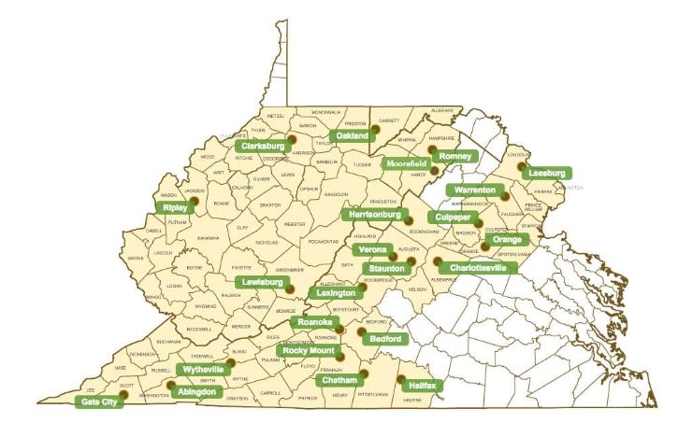
Who is Farm Credit?
The Farm Credit System is a nationwide network of lending cooperatives that serve rural America
Mission: to provide a reliable source of credit for American Agriculture by making loans and providing insurance to qualified borrowers

Slide 15
Farm Credit Knowledge Center
Our Mission: To Facilitate the Sharing of Knowledge and Resources within our Community for the Betterment of ALL Farmers and Those Interested in Agriculture
We serve as a “One Stop Shop” for Valuable Information, Data, Facts and Resources
Our team members are “Network Agents” where we strive to build relationships and make connections.
www.farmcreditknowledgecenter.com
Email: KnowledgeCenter@fcvirginias.com

